Slide 1
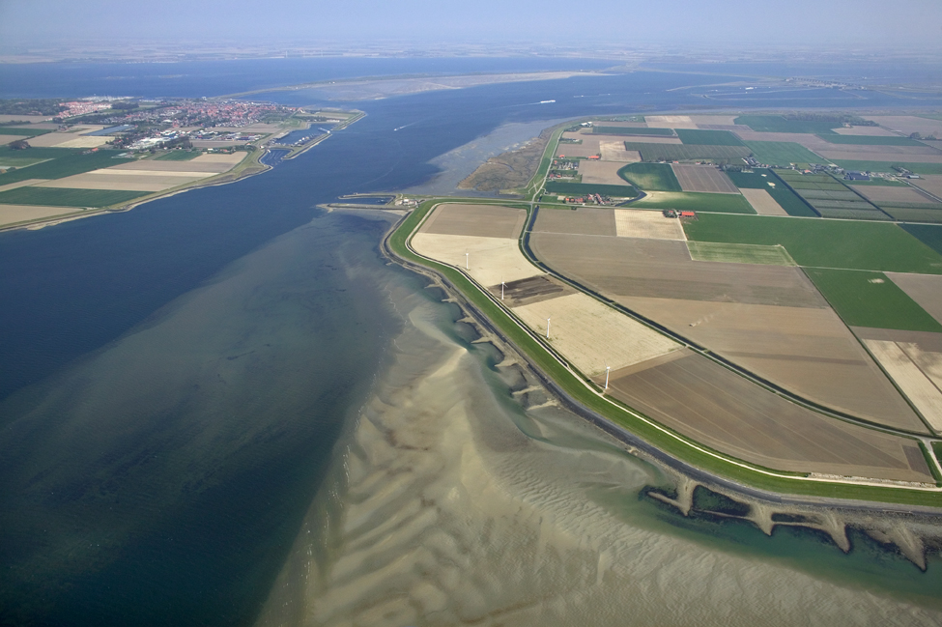


Importing gridded data

Slide 2
FEWS Gridded Data
Fews supports the display of both irregular and regular grids
Available (common) Import types
ArcInfoAscii
BIL
BUFR
CSV
PI
HDF5
NetCDF

Slide 3
FEWS Gridded Data
Commonly used data types
Precipitation
Soil Moisture
Pressure
Wind
Temperature
Water level
Wave height
Surge

Slide 4
FEWS Gridded Data
Data can be manipulated using transformation modules
Cookie cutter
Interpolation
Transformation
Data hierachy

Slide 5
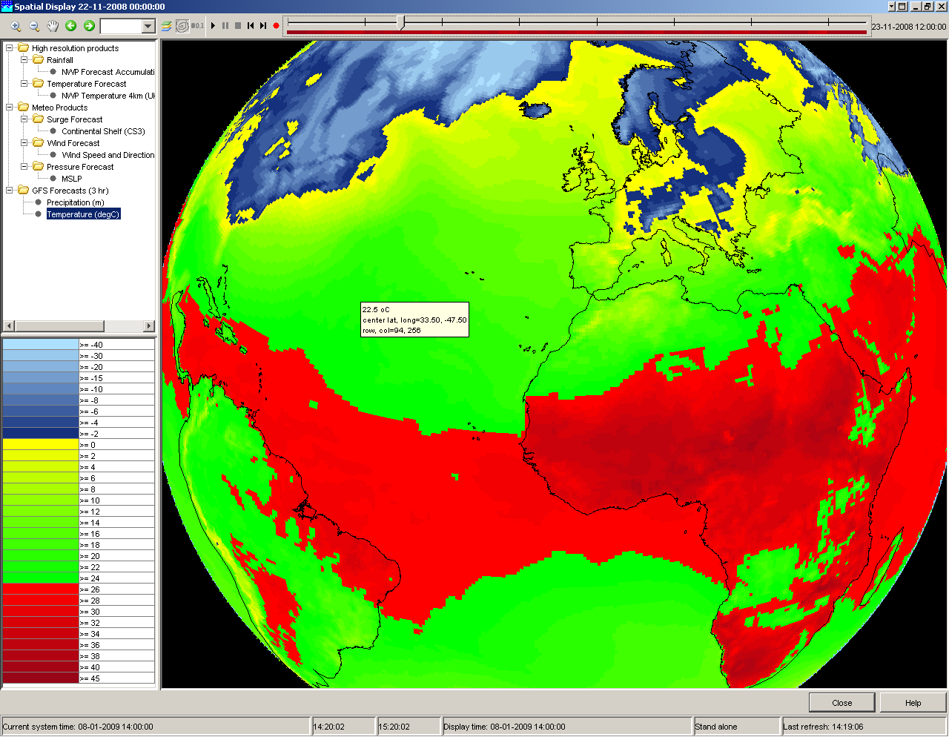
FEWS Gridded Data

Slide 6
Grid Import module
Before importing data, some questions must be answered:
What is the data format?
Does FEWS support this data format?
What is the coordinate system used in the grid?
Check supported coordinate systems in FEWS.
What are the grid dimensions?
Ask data supplier or use a data viewer that supports the format
What are the parameters and units used?
Ask data supplier or check on the internet
What are the time intervals used in the file?
How long do I want to store the data in the database?
Gridded data can be voluminous

Slide 7
Exercise
The exercise is split into three sections
Exercise 13: Import NWP forecasts
Exercise 14: Extract scalar series from gridded data
Exercise 15: Using the extracted scalar series in the model

Slide 8

Extracting series from Gridded
Data

Slide 9
Gridded Data – Exercise 13 - Questions
What forecast do you see?
How can you see a forecast for 3-10-2007 00:00:00
Time of Forecast
Series at 08:00
Series at 06:00
08:00
04:00
00:00

Slide 10
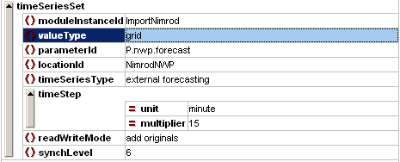
FEWS Time Series Sets: NWP
Properties of time series:
location Id – or – locationSetId
parameter Id
timestep
relativeViewPeriod
valueType (scalar, grid, profile, ..)
timeSeriesType (external historical, external forecast, ..)
moduleInstanceId (import, PDM, KW, ISIS, ..)
readWriteMode
expiryTime (when to delete from database)
synchLevel
simple transformations (delay, multiplier, divider, incrementer)
ensembleId

Slide 11
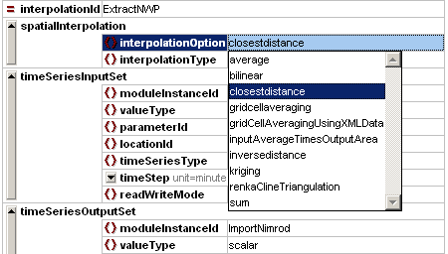
Extracting data from a Grid
The FEWS interpolation module can be used to extract series from a grid
For a location
extract the closest cell center (closestdistance)
For a catchment
extract average of cells within a polygon (average)
compute average of surrounding cells using bi-linear, kriging or inverse distance functions (bilinear, kriging, ..)
For a different grid
extract the closest cell center (closestdistance)

Slide 12
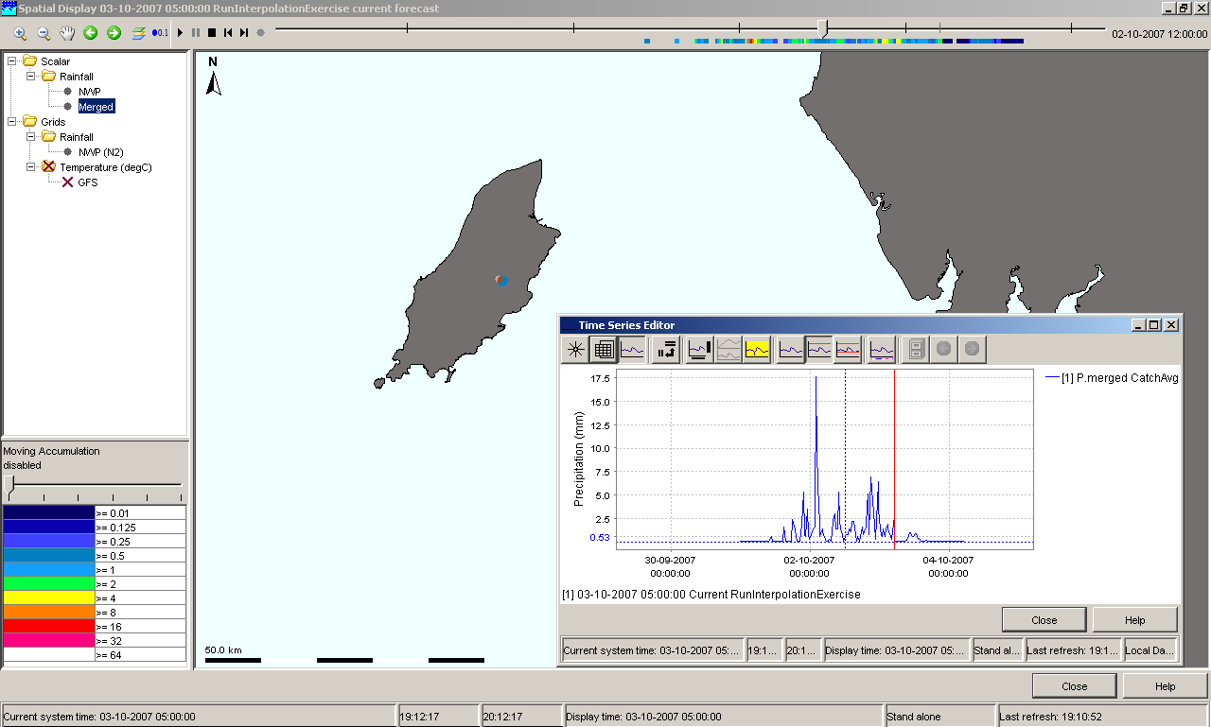
Display scalar time series in Spatial Display
With the FEWS Spatial Display it is possible to display, grids and scalar time series
Some functionality only works with grid series, other only with scalar series.

Slide 13
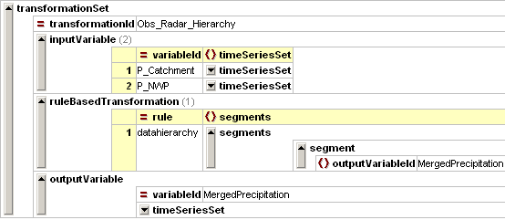
Merge forecast with observed series
The Transformation module is used to merge series into one (datahierarchy)
Merging observed precipitation with nwp forecast
What is the output series type (external forecast, simulated forecast)?

Slide 14
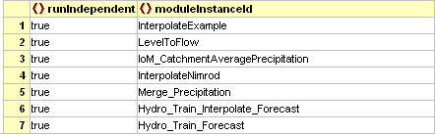
Add series to External Model
The RunInterpolationExercise Workflow contains 7 module instances
What can we do to use the P.merged series by the model?
Update the Hydro_Train_Interpolate_Forecast: use the P.merged series

Slide 15
Gridded Data – Exercises
The exercise is split into three sections
Exercise 13: Import NWP forecasts
Exercise 14: Extract scalar series from gridded data
Exercise 15: Using the extracted scalar series in the model

Slide 16
Issues when using Grid data

Slide 17
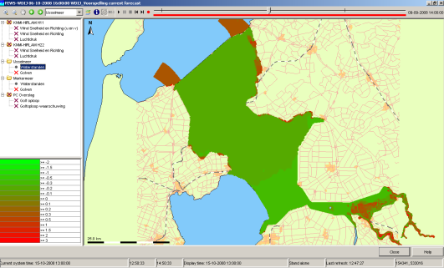
Issues when using grid data (1)
Is it always required to configure the Grid XML file?
No: In some cases these grid characteristics are included in the data files (GRIB).
Good example are ECMWF Forecasts
Bad example are MetOffice local surge models (characteristics only use 2 decimal places)
For an irregular grid the Cell centres must be included in the Grid xml file
No: it is also possible to use shape files with cell centres.
Since December 2008
Example: WAQUA models used in The Netherlands

Slide 18
Issues when using grid data (2)
In a Client-Server environment all imported grids are only stored in the Central Database
No:By using synchlevels it is possible to configure the data to be synchronised.
Examples of synchlevels will follow later today
The number of supported geodatums is limited to the enumeration in the config files
Yes: but
New geoDatums can be added by the FEWS Software developers
Try to use the polarStereographic or rotatedPoles elements (only regular grids)
Example KNMI Radar

Slide 19
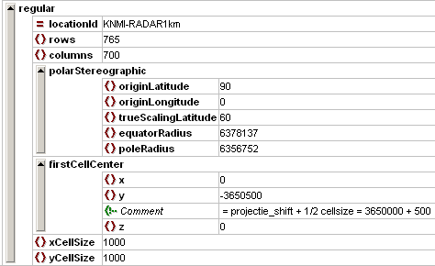
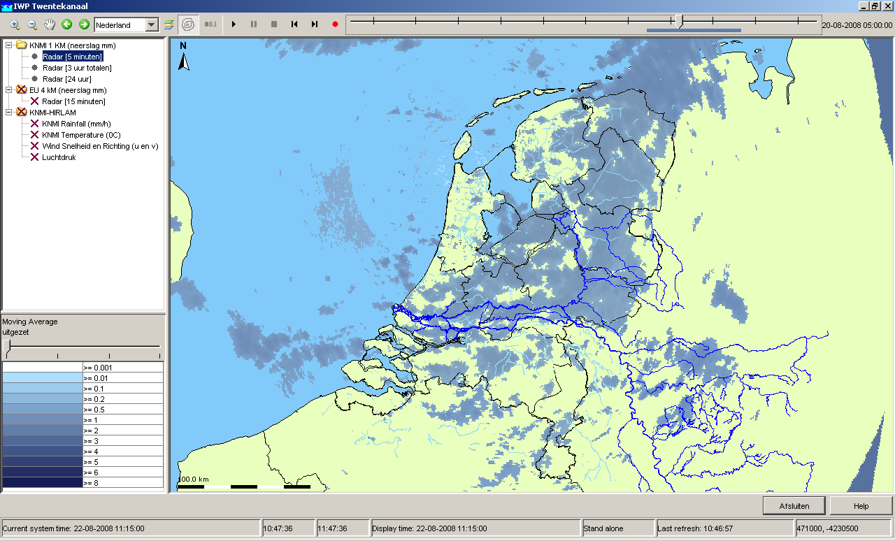
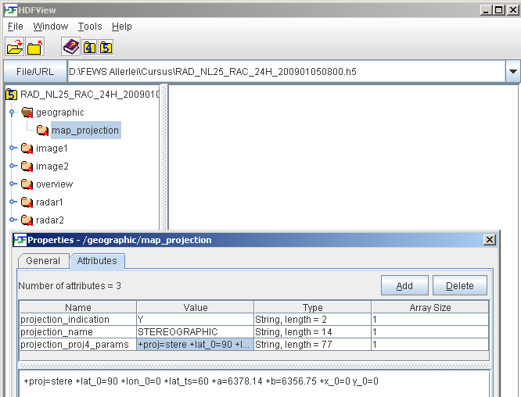
Issues when using grid data (3)
KNMI Radar

